Slide 1

TapIn "Build a Digital Business Card"
TAP Expo

Slide 2


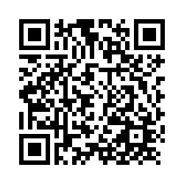
Pre-Survey
Scan QR code

Slide 3
TECHNOLOGY AMBASSADOR PROGRAM (TAP)
The Technology Ambassadors Program (TAP) aligns with GGC’s four pillars
Scholarship
Leadership
Service
Creativity
This award-winning program also addresses a need to increase the number of students who persist in an IT major or minor, particularly those underrepresented in computing.
Notes:
Open to any major as long as you have 2 IT courses.

Slide 4

Our Goals for this Project
Create a detailed Digital Business Card with general information that would be on a resume.
Motivate individuals to use/engage with technology to benefit their future.
Encourage individuals to continue working on their business card as they progress in their education.
"Forgot my resume.. No Problem!"

Slide 5
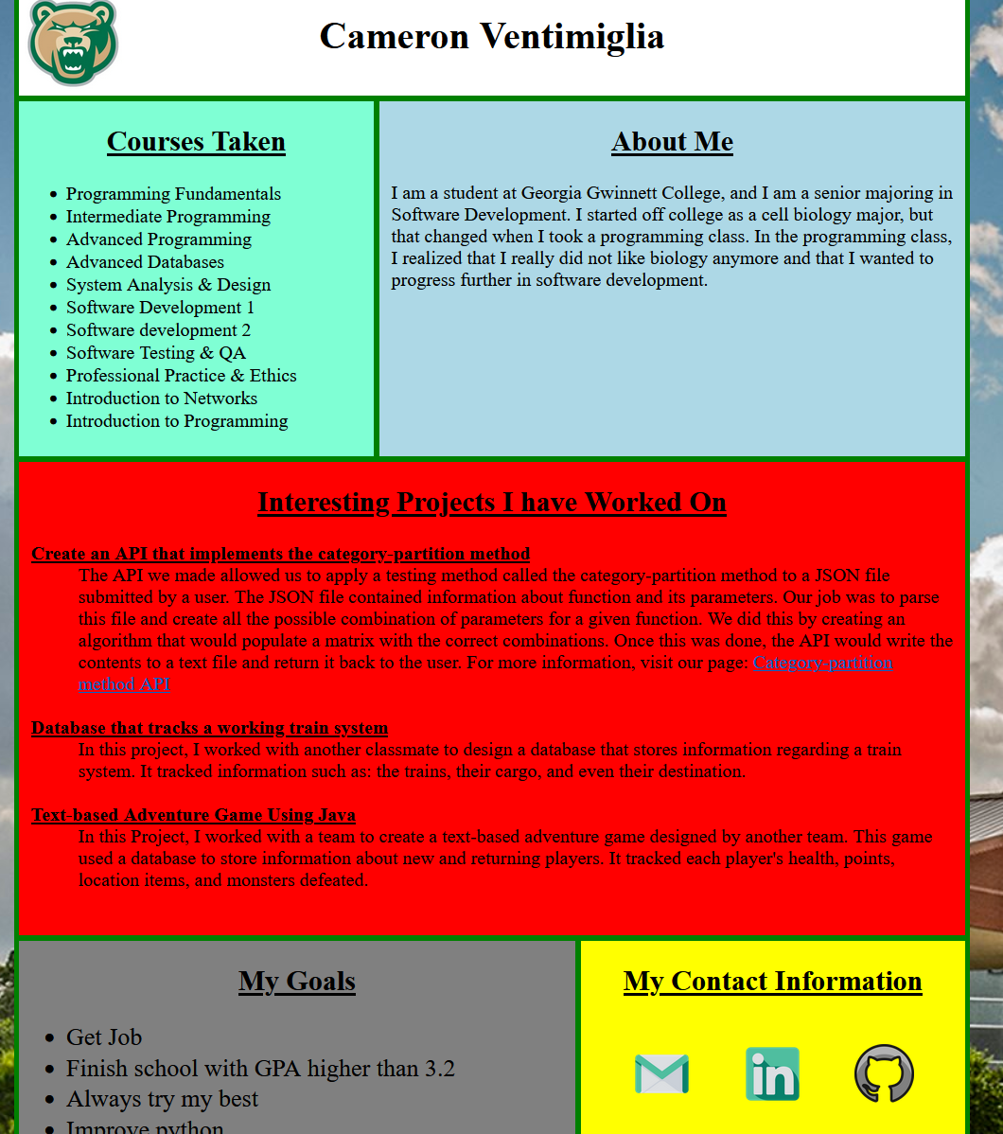

About Workshop
"Take your experience and store it in your pocket"
In this workshop, you will be creating a digital business card that you will link to an NFC chip (QR code if not in person) that you can share with anyone you come across in the future.
Technology used:
•Near Field Communication (NFC) Chips
What you will learn:
•What NFC chips are and how they work
•HTML, CSS, JavaScript arrays and for loops
Notes:
•Give detailed description what students are going to do in the workshop. •Give step by step directions. Do not assume the students know anything. •Make sure to INCLUDE PHOTOS!

Slide 6
NFC
Near Field Communication
Unlike Wi-Fi or Bluetooth, NFC is limited to an extremely short range.
An example of this kind of technology would be apple pay.
(radio frequency identification)

Slide 7
Navigate To Our GitHub Repository
https://github.com/TechAmbassadors-GGC/TapIn
QR code for Pre-survey

Slide 8
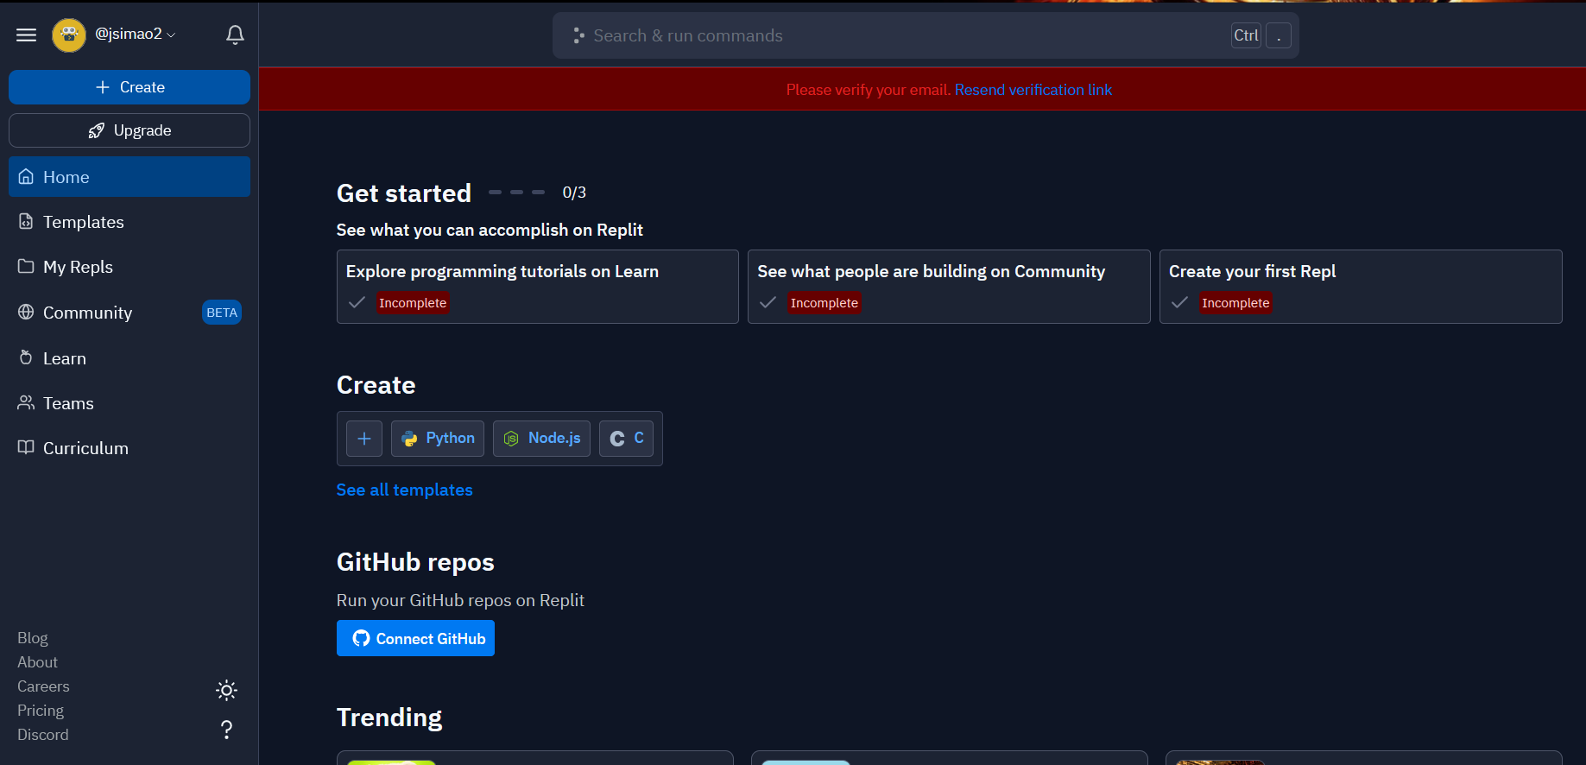
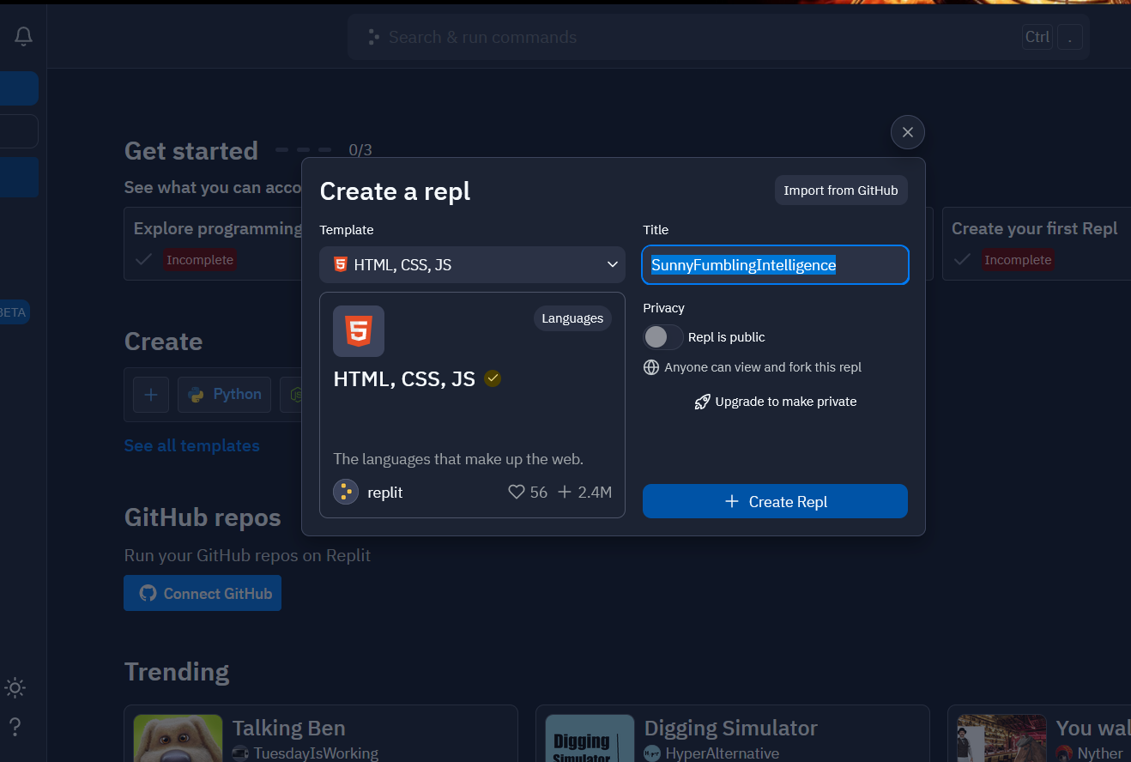
Getting Started
Go to link and Create a Replit account for free
Verify email if you want
Click create
Choose HTML, CSS, JS
Rename file with your name
+ Create repl

Slide 9
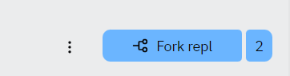
Forking the Repl
To fork this repl into your account, click on the blue button called “Fork repl”.

Slide 10
What is HTML?
HTML stands for Hypertext Markup Language
It is the standard language for creating documents that can be displayed in a web browser.

Slide 11

Structure of an HTML Document

Slide 12
Key points of an HTML file
There are two main section inside of an HTML file. They are the head and body sections.
The head section contains information about the webpage.
An example would be the title of the page and the location of a stylesheet used in for the file.
The body section contains text and elements that are displayed on the web page.
Everything you see on the page is written inside of the body section of the file.

Slide 13
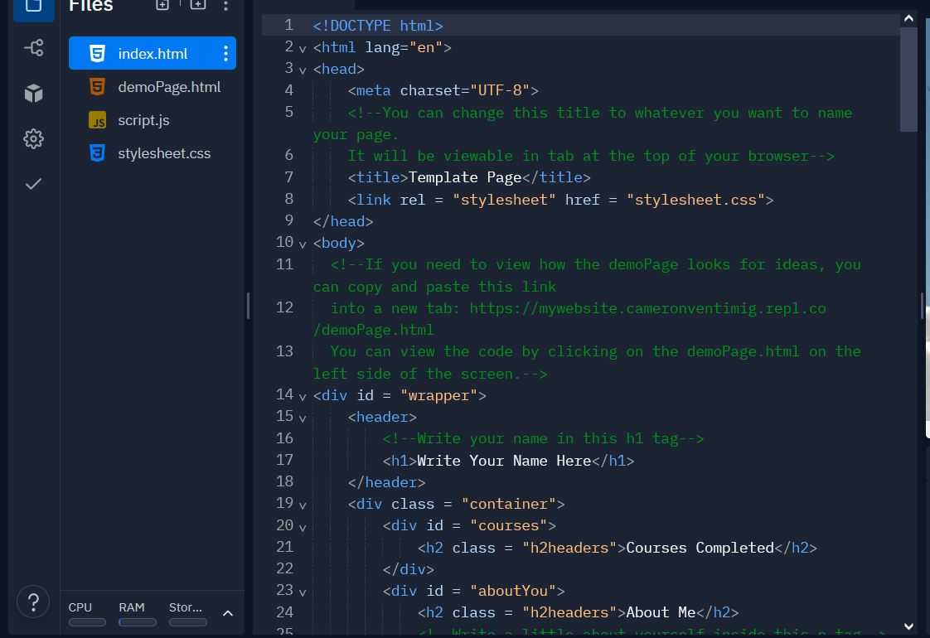
Open HTML File
Elements have an opening tag <> and a closing tag</>
Inside of <title></title> write what you want your card to be called. It will appear inside of the tab at the top of your browser.
In order to add your name to the main heading, you will need to change the contents in between <h1></h1>
Notes:
Explain tags, doctype, etc...

Slide 14
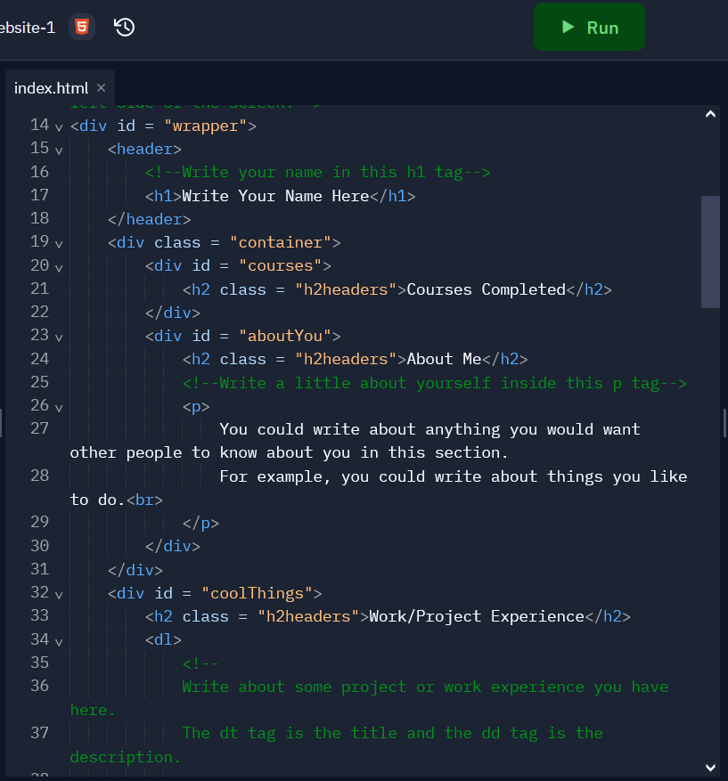
Edit your file
To change the information about yourself, you will need to change the contents between <p></p>
To change the title of your project or work experience, you will need to change the contents between the <dt></dt> tags.
To change the description of the project or work experience, you will need to change the contents between the <dd></dd> tags.

Slide 15
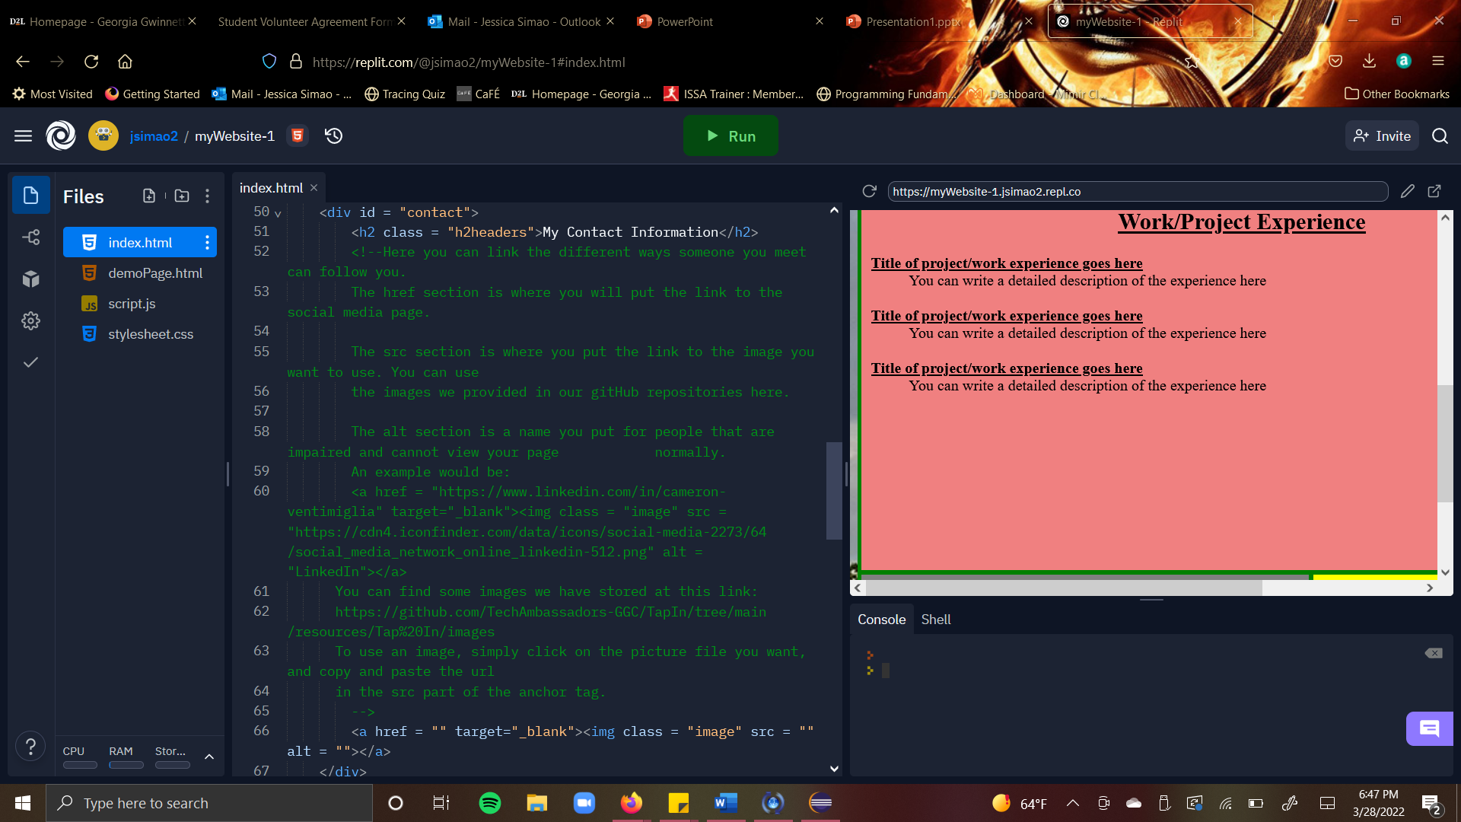
Modify contact section
To add a link, you need to change the contents inside of the <a></a> tag.
Href refers is the website you want to link to.
To make the URL take the form of an image, you will add an <img> tag in between of the <a></a> tag.
src refers to the link to the image you want to use.
Alt is a description for people who are unable to view your page due to physical impairments

Slide 16


Get links for file
<a></a>
Anchor Element
Specifies a hyperlink reference (href) to a file
Text between the <a> and </a> is displayed on the web page. <a href="contact.html">Contact Us</a>
href Attribute
Indicates the file name or URL
This Photo by Unknown author is licensed under CC BY.

Slide 17

What are Data Structures in Programming?
A data structure is internal storage a programmer can use to store, manipulate or access data inside of their program.
Popular data structures in programming:
Arrays
ArrayLists
Queues
Stacks
Maps
Trees

Slide 18
What is a JavaScript Array?
An array is an object that can store multiple values regardless of their data type. It is often used when we want to store a list of elements and access them by a single variable.
An example of how an array is created:
var house = ["bedroom", "kitchen", "garage"];
house is the array variable name
"bedroom", "kitchen", and "garage" are the elements of the house array.

Slide 19
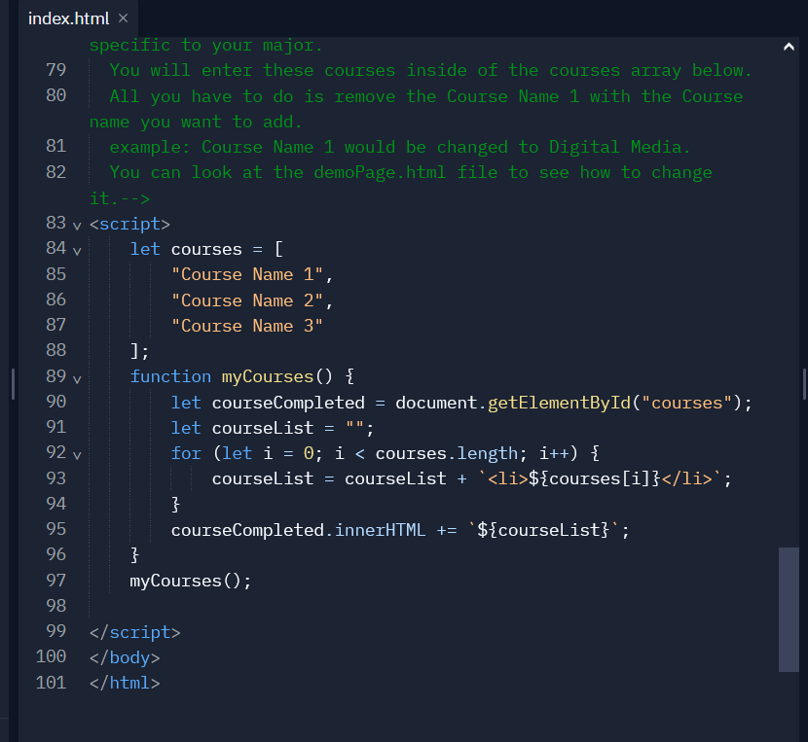
Fill in the array
Remove the placeholder elements and replace them with some courses you have completed.

Slide 20
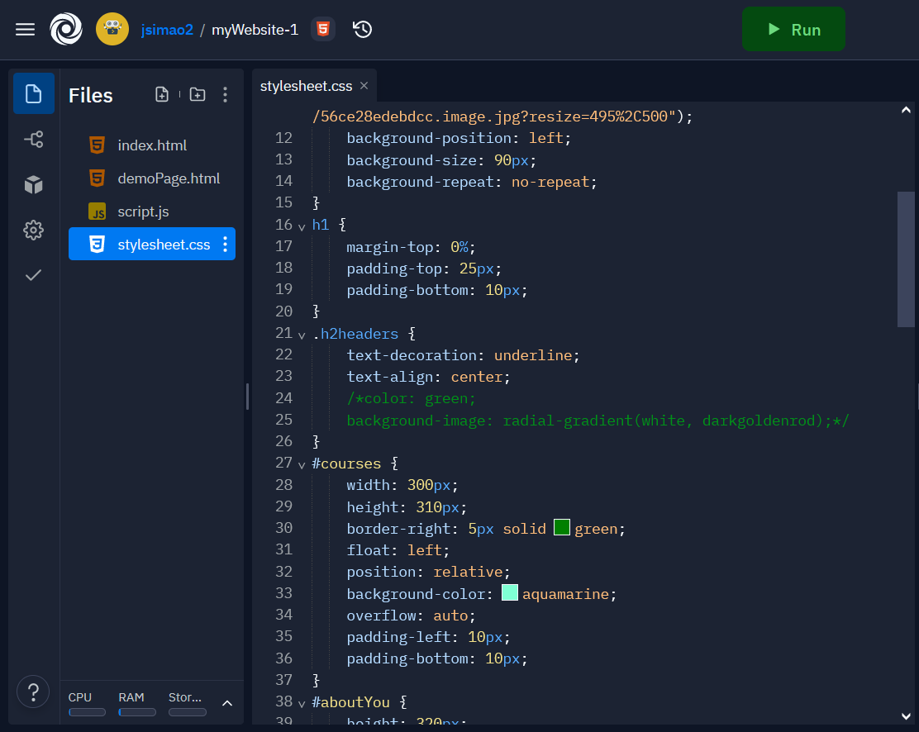
Cascading Style Sheet (css)
This is where most of the visual style of the webpage is kept.
Using html you can change colors, add pictures, reposition elements in the page, etc.....

Slide 21

Color Wheel!
https://www.w3schools.com/colors/colors_picker.asp

Slide 22
Changing the color of each section
If you want to change the color of each section, you will need to open the css file called “stylesheet.css”.
Inside of this file you will need to change the background-color of each section.
You can use a select amount of named colors or hexadecimal values
Hexadecimal values have a certain syntax that needs to be followed:
Starts with a #
Can only contain six digits
Can only contain numbers 0-9 and letters a-f
Good example: #123abc
Bad example: !123ht32
You can use a color picker to help generate these values for you.
https://www.w3schools.com/colors/colors_picker.asp (search w3 schools color picker in google)

Slide 23
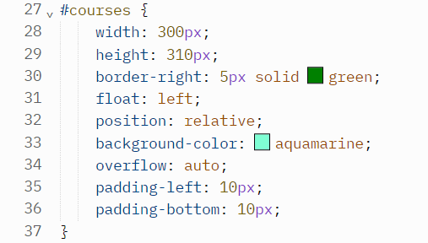
Example of what to change in the CSS file
You would want to change the background-color on line 33 to any color of your choosing.
If you need help, let us know.

Slide 24

Finalize html
Does everything look the way you want?
Do the links work when pressed?
(Troubleshooting...)

Slide 25
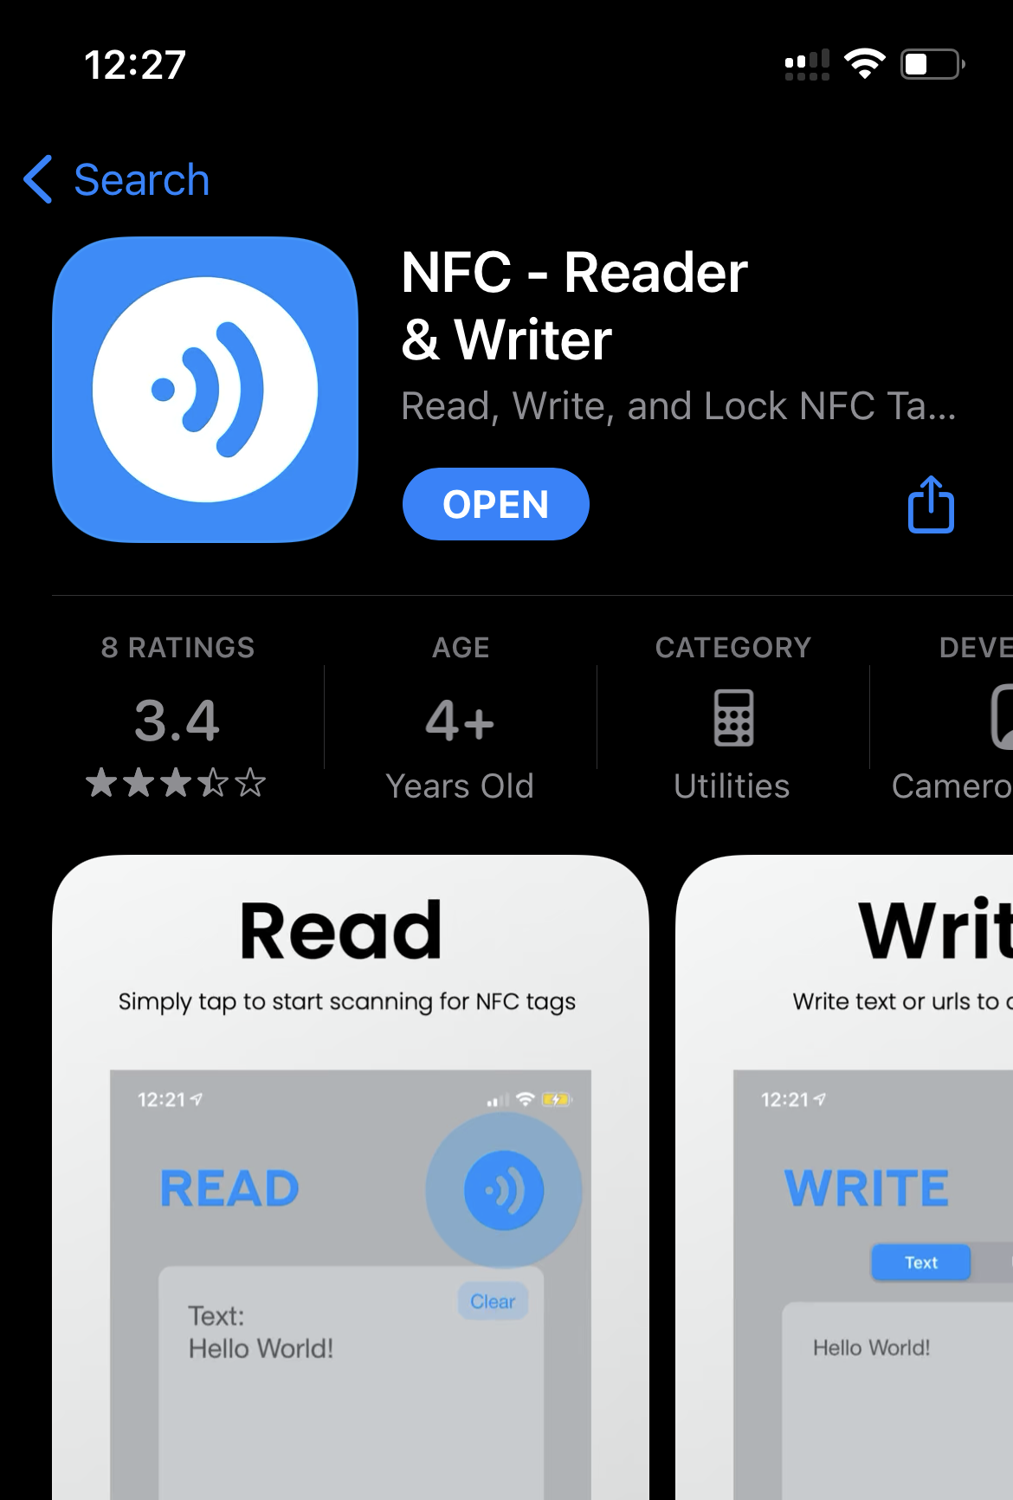
Connect Resume to NFC
Instructions:
Step 1: download NFC app that will read and write the nfc chip
Go to write
Enter the entire url link
Put NFC chip near the device and press write
Should say NFC sucessful!

Slide 26

Test your card!

Slide 27
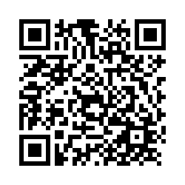
Post-Survey
Scan QR code

Slide 28

QUESTIONS?
Thank You!

